Slide 1
Internet Naming Service: DNS*

Slide 2
Overview
Introduction to the DNS
DNS Components
DNS Structure and Hierarchy
The DNS in Context

Slide 3
DNS History (1)
ARPANET utilized a central file HOSTS.TXT
  Contains names to addresses mapping
  Maintained by SRI’s NIC (Stanford-Research-Institute: Network-Information-Center)
Administrators email changes to NIC
  NIC updates HOSTS.TXT periodically
Administrators FTP (download) HOSTS.TXT
Notes:
Advanced Research Projects Agency Network (ARPANET) was the world's first operational packet switching network, the first network to implement TCP/IP

Slide 4
DNS History (2)
As the system grew, HOSTS.TXT had problems with:
  Scalability (traffic and load)
  Name collisions
  Consistency
In 1984, Paul Mockapetris released the first version (RFCs 882 and 883, superseded by 1034 and 1035 …)
Notes:
RFC: Request for Comments
RFC 882 - Domain names: Concepts and facilities

Slide 5
The DNS is…
The “Domain Name System”
What Internet users use to reference anything by name on the Internet
The mechanism by which Internet software translates names to attributes such as addresses

Slide 6
The DNS is also…
A globally distributed, scalable, reliable database
Comprised of three components
  A “name space”
  Servers making that name space available
  Resolvers (clients) which query the servers about the name space

Slide 7
DNS as a Lookup Mechanism
Users generally prefer names to numbers
Computers prefer numbers to names
DNS provides the mapping between the two
  I have “x”, give me “y”

Slide 8
DNS as a Database
Keys to the database are “domain names”
  www.foo.com, 18.in-addr.arpa, 6.4.e164.arpa
Over 200,000,000 domain names stored
Each domain name contains one or more attributes
  Known as “resource records”
Each attribute individually retrievable

Slide 9
Global Distribution
Data is maintained locally, but retrievable globally
  No single computer has all DNS data
DNS lookups can be performed by any device
Remote DNS data is locally cachable to improve performance

Slide 10
Loose Coherency
Each version of a subset of the database (a zone) has a serial number
  The serial number is incremented on each database change
Changes to the master copy of the database are propagated to replicas according to timing set by the zone administrator
Cached data expires according to timeout set by zone administrator

Slide 11
Scalability
No limit to the size of the database
No limit to the number of queries
  Tens of thousands of queries handled easily every second
Queries distributed among masters, slaves, and caches

Slide 12
Reliability
Data is replicated
  Data from master is copied to multiple slaves
Clients can query
  Master server
  Any of the copies at slave servers
Clients will typically query local caches
DNS protocols can use either UDP or TCP
  If UDP, DNS protocol handles retransmission, sequencing, etc.

Slide 13
Dynamicity
Database can be updated dynamically
  Add/delete/modify of any record
  Only master can be dynamically updated
Modification of the master database triggers replication

Slide 14
Overview
Introduction to the DNS
DNS Components
  The name space
  The servers
  The resolvers
DNS Structure and Hierarchy
The DNS in Context

Slide 15
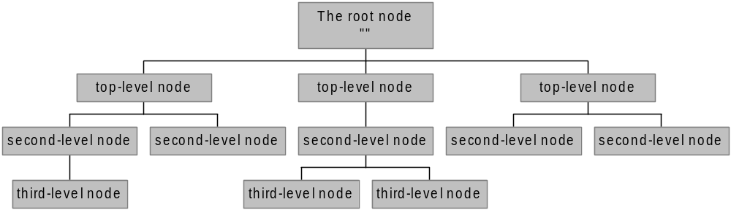
The Name Space
The name space is the structure of the DNS database
  An inverted tree with the root node at the top
Each node has a label
  The root node has a null label, written as “”

Slide 16
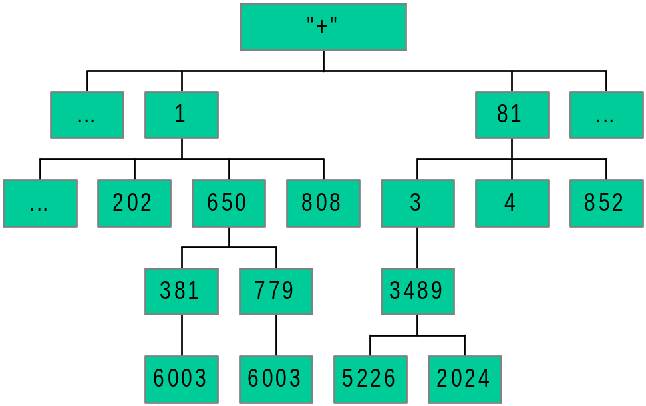
An Analogy – E.164
Root node maintained by the ITU (call it “+”)
Top level nodes = country codes (1, 81, etc)
Second level nodes = regional codes (1-402, 81-3, etc.)
Notes:
ITU: International Telecommunication Union
1: US/CA
81: JP

Slide 17
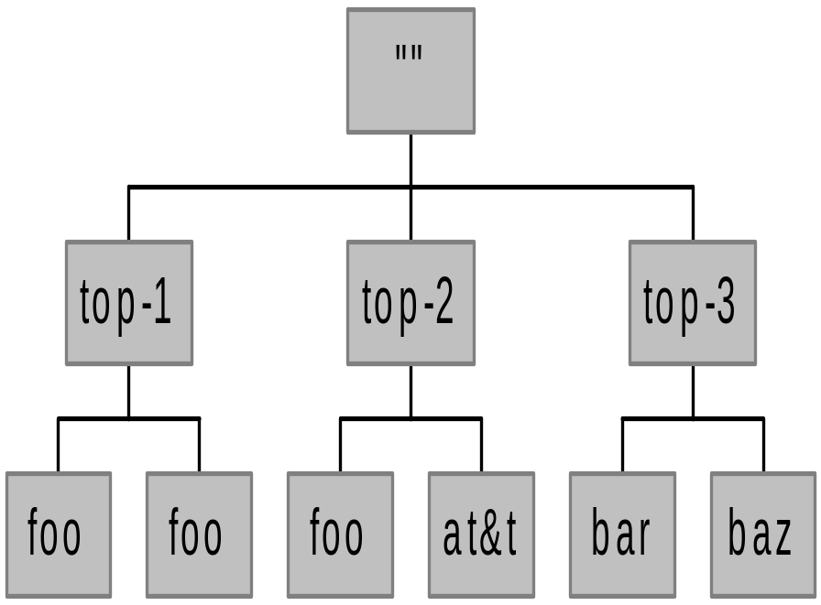
Labels
Each node in the tree must have a label
  A string of up to 63 bytes
  RFCs 852 and 1123 define legal characters for “hostnames”
    A-Z, 0-9, and “-” only with a-z and A-Z treated as the same
Sibling nodes must have unique labels
The null label is reserved for the root node

Slide 18
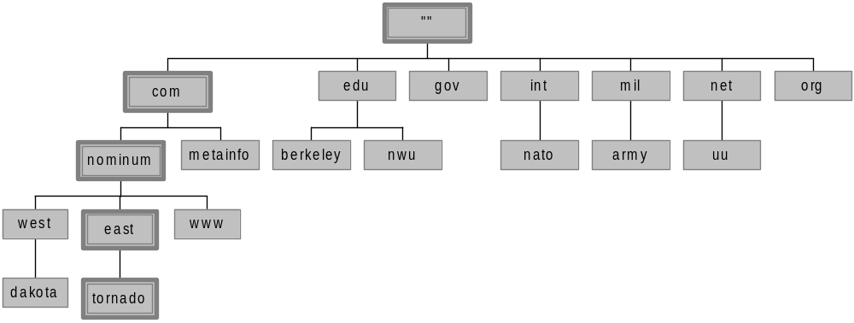
Domain Names
A domain name is the sequence of labels from a node to the root, separated by dots (“.”s), read left to right
  The name space has a maximum depth of 127 levels
  Domain names are limited to 255 characters in length
A node’s domain name identifies its position in the name space

Slide 19
Subdomains
One domain is a subdomain of another if its domain name ends in the other’s domain name
  So sales.nominum.com is a subdomain of
    nominum.com & com
  nominum.com is a subdomain of com

Slide 20
Delegation
Administrators can create subdomains to group hosts
  According to geography, organizational affiliation etc.
An administrator of a domain can delegate responsibility for managing a subdomain to someone else
The parent domain retains links to the delegated subdomains

Slide 21
Delegation Creates Zones
Each time an administrator delegates a subdomain, a new unit of administration is created
  The subdomain and its parent domain can now be administered independently
  These units are called zones
  The boundary between zones is a point of delegation in the name space
Delegation is good: it is the key to scalability

Slide 22
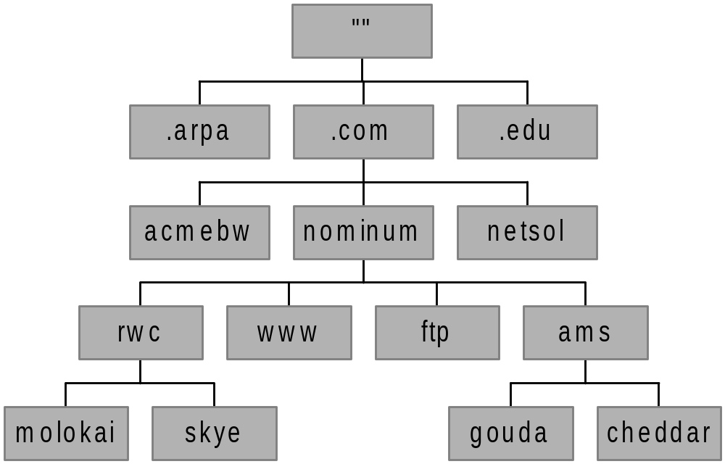
Dividing a Domain into Zones
nominum.com domain
nominum.com zone
ams.nominum.com zone
rwc.nominum.com zone

Slide 23
Overview
Introduction to the DNS
DNS Components
  The name space
  The servers
  The resolvers
DNS Structure and Hierarchy
The DNS in Context

Slide 24
Name Servers
Name servers store information about the name space in units called “zones”
  The name servers that load a complete zone are said to “have authority for” or “be authoritative for” the zone
Usually, more than one name server are authoritative for the same zone
  This ensures redundancy and spreads the load
Also, a single name server may be authoritative for many zones

Slide 25
Name Servers and Zones
128.8.10.5 serves data for both nominum.com and isc.org zones
Name Servers
Zones
128.8.10.5
nominum.com
202.12.28.129 serves data for nominum.com zone only
202.12.28.129
isc.org
204.152.187.11 serves data for isc.org zone only
204.152.187.11

Slide 26
Types of Name Servers
Two main types of servers
  Authoritative – maintains the data
    Master – where the data is edited
    Slave – where data is replicated to
  Caching – stores data obtained from an authoritative server
No special hardware necessary
Notes:
BIND: Berkeley Internet Name Domain

Slide 27
Name Server Architecture
You can think of a name server as part of:
  database server, answering queries about the parts of the name space it knows about (i.e., is authoritative for),
  cache, temporarily storing data it learns from other name servers, and
  agent, helping resolvers and other name servers find data
Notes:
Also, the caching resolver can insert data into the cache, and can "query" the cache and the database server.

Slide 28
Name Server Architecture
Zone
data
file
Name Server Process
From
disk
Authoritative Data
(primary master and
slave zones)
Master
server
Zone transfer
Cache Data
(responses from
other name servers)
Agent
(looks up queries
on behalf of resolvers)

Slide 29
Authoritative Data
Name Server Process
Authoritative Data
(primary master and
slave zones)
Response
Cache Data
(responses from
other name servers)
Agent
(looks up queries
on behalf of resolvers)
Resolver
Query

Slide 30
Using Other Name Servers
Name Server Process
Authoritative Data
(primary master and
slave zones)
Cache Data
(responses from
other name servers)
Response
Response
Another
name
server
Agent
(looks up queries
on behalf of resolvers)
Query
Resolver
Query

Slide 31
Cached Data
Name Server Process
Authoritative Data
(primary master and
slave zones)
Response
Cache Data
(responses from
other name servers)
Agent
(looks up queries
on behalf of resolvers)
Query
Resolver

Slide 32
Overview
Introduction to the DNS
DNS Components
  The name space
  The servers
  The resolvers
DNS Structure and Hierarchy
The DNS in Context

Slide 33
Name Resolution
Name resolution is the process by which resolvers and name servers cooperate to find data in the name space
Closure mechanism for DNS?
  Starting point: the names and IP addresses of the name servers for the root zone (the “root name servers”)
  The root name servers know about the top-level zones and can tell name servers whom to contact for all TLDs

Slide 34
Name Resolution
A DNS query has three parameters:
  A domain name (e.g., www.nominum.com),
    Remember, every node has a domain name!
  A class (e.g., IN), and
  A type (e.g., A)
  http://network-tools.com/nslook/
Upon receiving a query from a resolver, a name server
  1) looks for the answer in its authoritative data and its cache
  2) If step 1 fails, the answer must be looked up

Slide 35
The Resolution Process
Let’s look at the resolution process step-by-step:
annie.west.sprockets.com
ping www.nominum.com.

Slide 36
The Resolution Process
The workstation annie asks its configured name server, dakota, for www.nominum.com’s address
dakota.west.sprockets.com
What’s the IP address of www.nominum.com?
annie.west.sprockets.com
ping www.nominum.com.

Slide 37
The Resolution Process
The name server dakota asks a root name server, m, for www.nominum.com’s address
m.root-servers.net
dakota.west.sprockets.com
What’s the IP address of www.nominum.com?
annie.west.sprockets.com
ping www.nominum.com.

Slide 38
The Resolution Process
The root server m refers dakota to the com name servers
This type of response is called a “referral”
m.root-servers.net
dakota.west.sprockets.com
Here’s a list of the com name servers. Ask one of them.
annie.west.sprockets.com
ping www.nominum.com.

Slide 39
The Resolution Process
The name server dakota asks a com name server, f, for www.nominum.com’s address
What’s the IP address of www.nominum.com?
m.root-servers.net
dakota.west.sprockets.com
f.gtld-servers.net
annie.west.sprockets.com
ping www.nominum.com.

Slide 40
The Resolution Process
The com name server f refers dakota to the nominum.com name servers
Here’s a list of the nominum.com name servers. Ask one of them.
m.root-servers.net
dakota.west.sprockets.com
f.gtld-servers.net
annie.west.sprockets.com
ping www.nominum.com.

Slide 41
The Resolution Process
The name server dakota asks a nominum.com name server, ns1.sanjose, for www.nominum.com’s address
What’s the IP address of www.nominum.com?
m.root-servers.net
dakota.west.sprockets.com
ns1.sanjose.nominum.net
f.gtld-servers.net
annie.west.sprockets.com
ping www.nominum.com.

Slide 42
The Resolution Process
The nominum.com name server ns1.sanjose responds with www.nominum.com’s address
m.root-servers.net
dakota.west.sprockets.com
Here’s the IP address for www.nominum.com
ns1.sanjose.nominum.net
f.gtld-servers.net
annie.west.sprockets.com
ping www.nominum.com.

Slide 43
The Resolution Process
The name server dakota responds to annie with www.nominum.com’s address
Here’s the IP address for www.nominum.com
m.root-servers.net
dakota.west.sprockets.com
ns1.sanjose.nominum.net
f.gtld-servers.net
annie.west.sprockets.com
ping www.nominum.com.

Slide 44
Resolution Process (Caching)
After the previous query, the name server dakota now knows:
  The names and IP addresses of the com name servers
  The names and IP addresses of the nominum.com name servers
  The IP address of www.nominum.com
Let’s look at the resolution process again
annie.west.sprockets.com
ping ftp.nominum.com.

Slide 45
Resolution Process (Caching)
The workstation annie asks its configured name server, dakota, for ftp.nominum.com’s address
m.root-servers.net
dakota.west.sprockets.com
What’s the IP address of ftp.nominum.com?
ns1.sanjose.nominum.net
f.gtld-servers.net
annie.west.sprockets.com
ping ftp.nominum.com.

Slide 46
Resolution Process (Caching)
dakota has cached a NS record indicating ns1.sanjose is an nominum.com name server, so it asks it for ftp.nominum.com’s address
What’s the IP address of ftp.nominum.com?
m.root-servers.net
dakota.west.sprockets.com
ns1.sanjose.nominum.net
f.gtld-servers.net
annie.west.sprockets.com
ping ftp.nominum.com.

Slide 47
Resolution Process (Caching)
The nominum.com name server ns1.sanjose responds with ftp.nominum.com’s address
m.root-servers.net
dakota.west.sprockets.com
Here’s the IP address for ftp.nominum.com
ns1.sanjose.nominum.net
f.gtld-servers.net
annie.west.sprockets.com
ping ftp.nominum.com.

Slide 48
Resolution Process (Caching)
The name server dakota responds to annie with ftp.nominum.com’s address
Here’s the IP address for ftp.nominum.com
m.root-servers.net
dakota.west.sprockets.com
ns1.sanjose.nominum.net
f.gtld-servers.net
annie.west.sprockets.com
ping ftp.nominum.com.

Slide 49
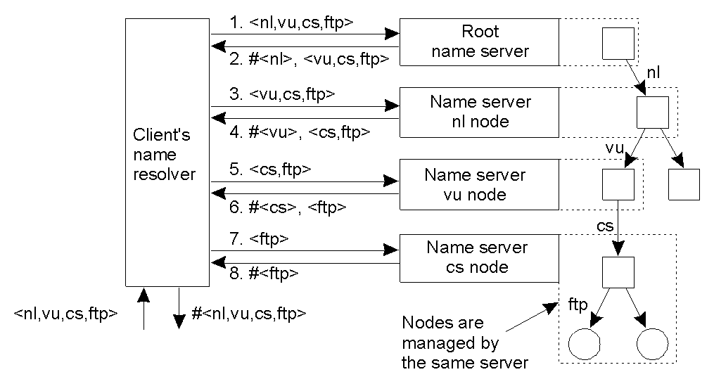
Iterative Name Resolution
The principle of iterative name resolution.

Slide 50
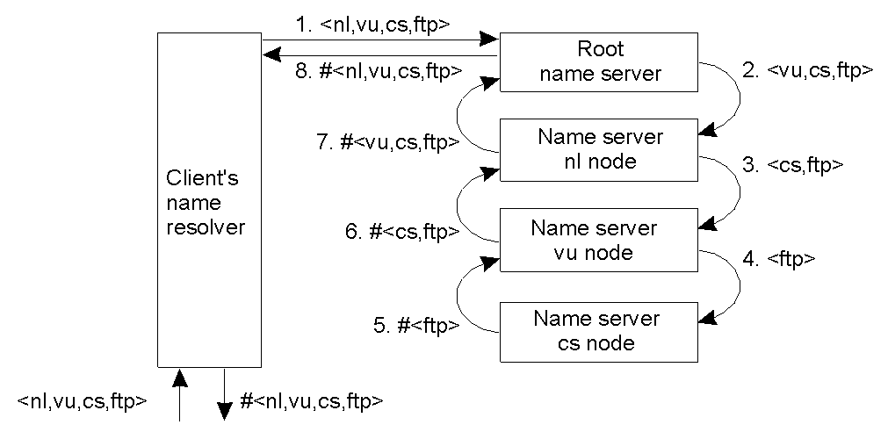
Recursive Name Resolution (1)
The principle of recursive name resolution.

Slide 51
Recursive Name Resolution (2)
Server for node | Should resolve | Looks up | Passes to child | Receives and caches | Returns to requester
cs | <ftp> | #<ftp> | -- | -- | #<ftp>
vu | <cs,ftp> | #<cs> | <ftp> | #<ftp> | #<cs> #<cs, ftp>
ni | <vu,cs,ftp> | #<vu> | <cs,ftp> | #<cs> #<cs,ftp> | #<vu> #<vu,cs> #<vu,cs,ftp>
root | <ni,vu,cs,ftp> | #<nl> | <vu,cs,ftp> | #<vu> #<vu,cs> #<vu,cs,ftp> | #<nl> #<nl,vu> #<nl,vu,cs> #<nl,vu,cs,ftp>
Recursive name resolution of <nl, vu, cs, ftp>. Name servers cache intermediate results for subsequent lookups.

Slide 52
Iterative versus Recursive Resolution (1)
Performance-wise, which is better?
Which works better with caching?
How about communication cost?

Slide 53
Iterative versus Recursive Resolution (2)
Performance-wise, which is better?
  Recursive method puts higher performance demand on each name server
Which works better with caching?
  Recursive method works better with caching
How about communication cost?
  Recursive method can reduce communication cost

Slide 54
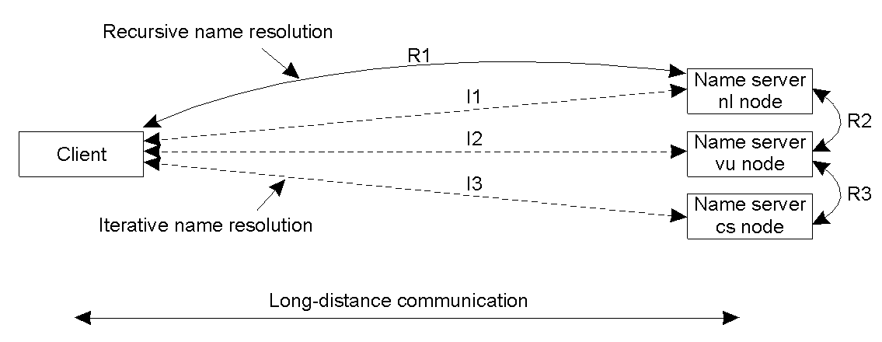
Iterative versus Recursive Resolution (3)
The comparison between recursive and iterative name resolution with respect to communication costs.

Slide 55
Overview
Introduction to the DNS
DNS Components
DNS Structure and Hierarchy
The DNS in Context

Slide 56
DNS Structure and Hierarchy
The DNS imposes no constraints on how the DNS hierarchy is implemented except:
  A single root
  The label restrictions
  So, can we create a host with a name a.wonderful.world?
If a site is not connected to the Internet, it can use any domain hierarchy it chooses
  Can make up whatever TLDs (top level domains) you want
Connecting to the Internet implies use of the existing DNS hierarchy

Slide 57
Top-level Domain (TLD) Structure
In 1983 (RFC 881), the idea was to have TLDs correspond to network service providers
  e.g., ARPA, DDN, CSNET, etc.
    Bad idea: if your network changes, your name changes
By 1984 (RFC 920), functional domains was established
  e.g., GOV for Government, COM for commercial, EDU for education, etc.
RFC 920 also
  Provided country domains
  Provided “Multiorganizations”
    Large, composed of other (particularly international) organizations
  Provided a stable TLD structure until 1996 or so
Notes:
ARPA: Advanced Research Projects Agency

Slide 58
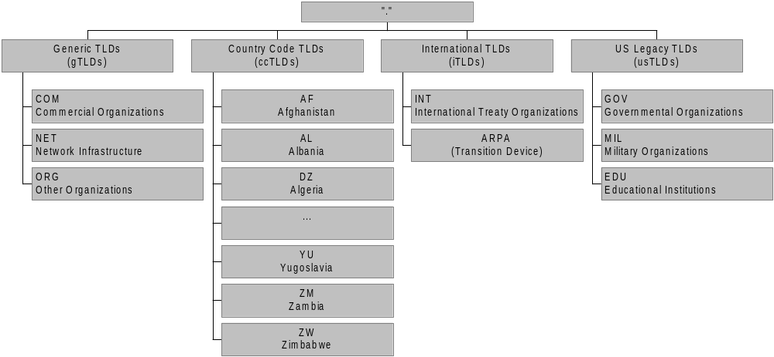
The Current TLDs
Notes:
ARPA: originally was the acronym for the Advanced Research Projects Agency (ARPA), the funding organization in the United States that developed the precursor of the Internet (ARPANET),
it now stands for Address and Routing Parameter Area.

Slide 59
Internet Corporation for Assigned Names and Numbers (ICANN)
ICANN’s role: to oversee the management of Internet resources including
  Addresses
    Delegating blocks of addresses to the regional registries
  Protocol identifiers and parameters
    Allocating port numbers, etc.
  Names
    Administration of the root zone file
    Oversee the operation of the root name servers
Notes:
Root zone file lists the names and numeric IP addresses of the authoritative DNS servers for all top-level domains (TLDs)

Slide 60
The Root Nameservers
The root zone file lists the names and IP addresses of the authoritative DNS servers for all top-level domains (TLDs)
The root zone file is published on 13 servers, “A” through “M”, around the Internet
Root name server operations currently provided by volunteer efforts by a very diverse set of organizations

Slide 61
Root Name Server Operators
Nameserver | Operated by:
A | Verisign (US East Coast)
B | University of S. California –Information Sciences Institute (US West Coast)
C | Cogent Communications (US East Coast)
D | University of Maryland (US East Coast)
E | NASA (Ames) (US West Coast)
F | Internet Software Consortium (US West Coast)
G | U. S. Dept. of Defense (ARL) (US East Coast)
H | U. S. Dept. of Defense (DISA) (US East Coast)
I | Autonomica (SE)
J | Verisign (US East Coast)
K | RIPE-NCC (UK)
L | ICANN (US West Coast)
M | WIDE (JP)

Slide 62
Registries, Registrars, and Registrants
A classification of roles in the operation of a domain name space
Registry
  the name space’s database
  the organization which has edit control of that database
  the organization which runs the authoritative name servers for that name space
Registrar
  the agent which submits change requests to the registry on behalf of the registrant
Registrant
  the entity which makes use of the domain name

Slide 63
Registries, Registrars, and Registrants
Registry updates
zone
Master
updated
Registry
Zone DB
Registrar submits
add/modify/delete
to registry
Slaves
updated
Registrar
Registrar
Registrar
End user requests
add/modify/delete
Registrants

Slide 64
Verisign: the registry and registrar for gTLDs
.COM, .NET, and .ORG
  By far the largest top level domains on the Internet today
Verisign received the contract for the registry for .COM, .NET, and .ORG
  also a registrar for these TLDs

Slide 65
Overview
Introduction to the DNS
DNS Components
DNS Hierarchy
The DNS in Context

Slide 66
Load Concerns
DNS can handle the load
  DNS root servers get approximately 3000 queries per second
    Empirical proofs (DDoS attacks) show root name servers can handle 50,000 queries per second
      Limitation is network bandwidth, not the DNS protocol
  in-addr.arpa zone, which translates numbers to names, gets about 2000 queries per second

Slide 67
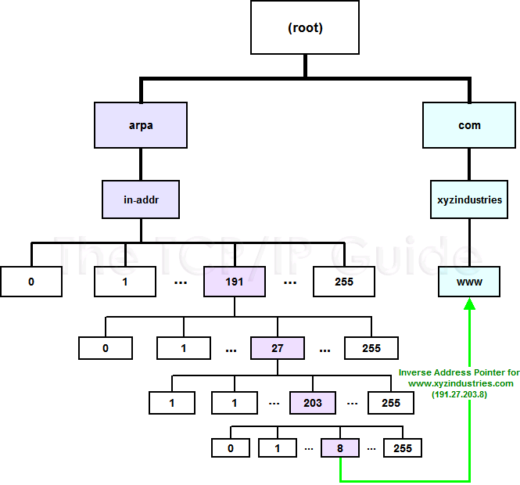

Slide 68
Performance Concerns
DNS is a very lightweight protocol
  Simple query – response
Any performance limitations are the result of network limitations
  Speed of light
  Network congestion
  Switching/forwarding latencies

Slide 69
Security Concerns
Base DNS protocol (RFC 1034, 1035) is insecure
  DNS spoofing (cache poisoning) attacks are possible
DNS Security Enhancements (DNSSEC, RFC 2565) remedies this flaw
  But creates new ones
    DoS attacks
    Amplification attacks
DNSSEC strongly discourages large flat zones
  Hierarchy (delegation) is good
Notes:
a spoofing attack is a situation in which one person or program successfully masquerades as another by falsifying data

